Slide 1

Association of Agricultural Research Institutions in the Near East and North Africa
AARINENA
AARINENA’s Role in Research and Innovation

Slide 2
The Association of Agricultural Research Institutions in the Near East and North Africa (AARINENA) was established in 1985 to strengthen cooperation among national, regional and international research institutions and centers through the dissemination and exchange of information, experiences and research results.
History

Slide 3
AARINENA aspires to be the hub for NENA agricultural stakeholders who strive to jointly strengthen and transform agricultural research and innovation to effectively address challenges and realize together a sustainable, inclusive and prosperous future for the region.
Vision

Slide 4
As a unique network of representative multi-sector partners, AARINENA promotes and facilitates the development of state-of-the-art transformational solutions that enable NENA agricultural research and innovation systems to address more effectively critical and pressing agricultural and innovation challenges. In this respect, AARINENA focuses on mobilizing dialogue, knowledge exchange and partnerships over collective actions; empowering rural women, youth and small holder farmers; impacting policies, and strengthening capacities of NENA agricultural and innovation systems.
Mission

Slide 5
1
West Asian Sub-Region
2
Mashreq Sub-Region
Sub-Regions of AARINENA
3
Arabian Peninsula Sub-Region
4
Nile Valley and Red Sea Sub-Region
5
Maghreb Sub-Region

Slide 6
Establish AARINENA as a global knowledge platform to facilitate, mobilize and coordinate multilateral exchange and dissemination of actionable specific and transversal knowledge among stakeholders at south-south and south-north levels.
1
Goals
Support and enhance multi-stakeholder partnerships over collective dialogues and actions, aiming at collectively building up open systems of agricultural research and innovation that are more effective in finding innovative and applicable solutions.
2

Slide 7
Facilitate and coordinate education and capacity strengthening of various partners to enable them to communicate and interact effectively within agricultural research and innovation open systems. This will include promoting the transformation of higher education and research, and reforming research and innovation organizations and their governances in alignment with the goal of developing efficient open systems and in accordance with agreed upon AARINENA mission and goals.
Goals
3

Slide 8
Contribute to advancing rural women, youth and small holder farmers along the agricultural value chains through promoting collective actions among open agricultural R&I systems that prepare these targeted populations for employment and entrepreneurial opportunities in order to improve their income, enable them to impact relevant policies, and make rural areas attractive to them.
4
Goals
Strengthen the architecture of AARINENA to enable the fora to perform and realize its reviewed mission, goals and expected outcomes & impact.
5

Slide 9
Knowledge Sharing: Exchanging valuable knowledge, expertise, and best practices in agricultural research, development, and advisory services. This collaboration can help both organizations enhance their understanding of regional agricultural challenges and identify innovative solutions.
1
Collaboration with AARINENA
Capacity Building: By working together, we can facilitate capacity-building initiatives for agricultural researchers, extension agents, and policymakers in Arab and African countries. This includes training programs, workshops, and seminars aimed at improving agricultural productivity, sustainability, and resilience.
2

Slide 10
Resource Mobilization: Collaborative efforts can attract funding and resources from international donors, governments, and other stakeholders. Pooling resources allows for the implementation of larger-scale projects and initiatives that address common agricultural issues in the Arab and African regions.
3
Collaboration with AARINENA
Policy Influence: By aligning our agendas and priorities, we can advocate for evidence-based policies and strategies that support agricultural development, food security, and rural livelihoods. Together, they can amplify their voices and influence decision-making processes at regional and international levels.
4

Slide 11
Networking and Partnerships: Collaboration enables both organizations to expand their networks and forge strategic partnerships with other regional and global stakeholders, including academic institutions, research organizations, NGOs, and private sector entities. These partnerships can facilitate the exchange of ideas, resources, and technologies for mutual benefit.
5
Collaboration with AARINENA
Innovation and Technology Transfer: Both organizations can collaborate on promoting innovation in agriculture and facilitating the transfer of appropriate technologies to farmers and agribusinesses. This includes promoting the adoption of climate-smart practices, digital agriculture solutions, and value-added processing techniques to enhance productivity and market access.
6

Slide 12
Monitoring and Evaluation: Joint monitoring and evaluation mechanisms can be established to assess the impact of collaborative initiatives undertaken by both organizations. By tracking progress and measuring outcomes, both organizations can ensure accountability and continuous improvement in their efforts to support agricultural development in the Arab and African regions.
Collaboration with AARINENA
7

Slide 13
1
Plant Genetic Resources Network
Water Use Efficiency Network
Date Palm Network
Olive Network
Animal Production and Health Network
6
Plant Protection Network
Forgotten Foods, Neglected Crops and Underutilized Species (FF-NUS) Network
Agribusiness Sub-network
Honey Bees Sub-network
Biotechnology Network
2
7
Networks of AARINENA
3
8
4
9
5
10
11
Medicinal and Herbal Plants Network

Slide 14
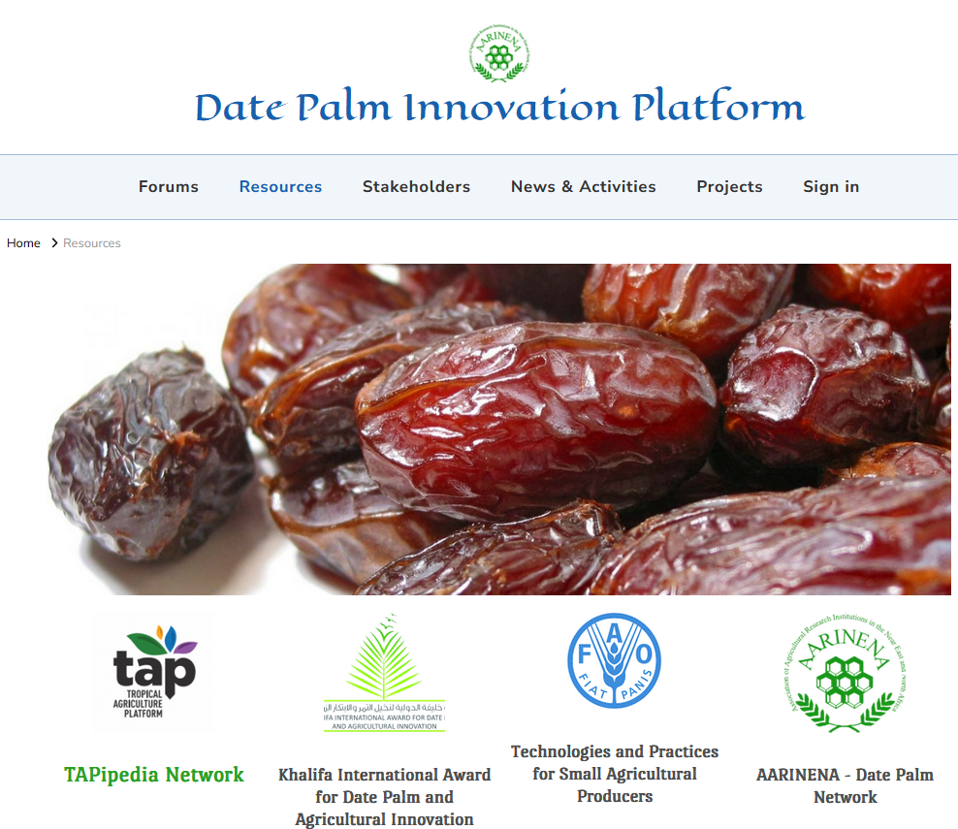
Date Palm Innovation Platform (2023)
Latest Projects of AARINENA

Slide 15
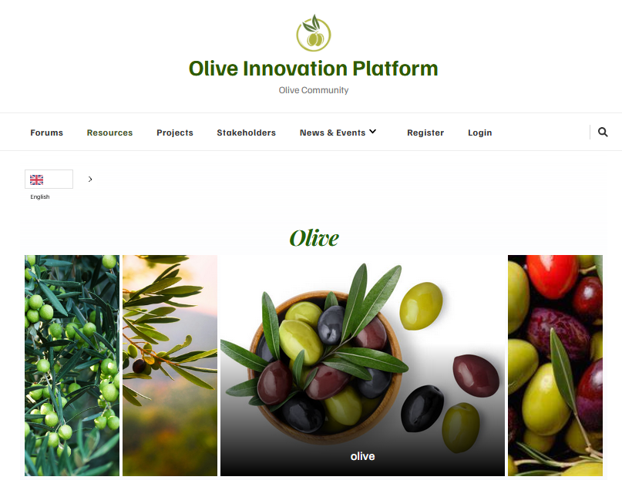
Olive Innovation Platform (2024)
Latest Projects of AARINENA

Slide 16

Thank you ..

