Slide 1

Asia-Pacific Association of Agricultural Research Institutions
APAARI’s Role in Research and Innovation
Partnerships • Knowledge • Capacity • Policy

Slide 2
The Asia-Pacific Association of Agricultural Research Institutions (APAARI) was founded in 1990 by the initiative of the Food and Agriculture Organization of the United Nations (FAO) and Governments of China, Fiji, India, Iran, Malaysia, New Zealand, Pakistan, Papua New Guinea, Philippines, Republic of Korea, Sri Lanka, Thailand and Western Samoa.
History

Slide 3
Vision
“Strengthened research and innovations for sustainable agricultural development in Asia and the Pacific”.

Slide 4
Mission
“Promoting, coordinating and strengthening agriculture and agri-food research and innovation systems through partnerships and collaboration, capacity development and advocacy for sustainable agricultural development in Asia and the Pacific.”

Slide 5
Sub-Regions of APAARI
South Asia
Southeast Asia
West Asia
Pacific

Slide 6
APAARI Goals / Strategic Objectives
🌱 Sustainable Agriculture: Improve agricultural production and productivity through sustainable farming and agroecology.
🌾 Healthy Value Chains: Strengthen local value chains for healthy and nutritious crops.
💡 Innovation & Technology: Promote appropriate innovative technologies and processes for effective agri-food systems.
🌏 Safe Agri-food Trade: Strengthen compliance with international agri-food trade norms.
🌿 Climate & Biodiversity: Promote agrobiodiversity, climate resilience and environmental sustainability through innovation.
Goals

Slide 7
Knowledge Sharing & Exchange
Collaborate in knowledge management, information exchange, documentation and dissemination of research, innovations, technologies and good practices across the Asia-Pacific region.
Research & Innovation Partnerships
Develop joint research and innovation activities, projects and programmes among APAARI members and national, sub-regional, regional and global organizations.
Capacity Development
Work together on training, mentoring, staff exchange, institutional strengthening and development of technical, scientific and managerial capacities.
Collaboration with APAARI

Slide 8
Regional Networking & Partnerships
Build strategic partnerships and cross-linkages among agricultural research and innovation institutions, universities, development organizations, private sector and other stakeholders.
Policy Dialogue & Advocacy
Collaborate on policy-related conferences, dialogues and evidence-based discussions to strengthen agricultural and agri-food research and innovation systems.
Resource Mobilization
Work with APAARI to mobilize financial, human and partnership resources and develop joint initiatives that benefit countries and stakeholders in the Asia-Pacific region.
Collaboration with APAARI

Slide 9
Regional Projects & Technical Cooperation
APAARI can initiate, collaborate on and coordinate technical and scientific projects at national, sub-regional, regional and global levels. For example, APAARI currently undertakes project coordination and implementation roles in areas such as phytosanitary systems, agricultural trade and capacity development.
Collaboration with APAARI

Slide 10
Networks & Stakeholders of APAARI
National Research → NARIs • NAROs • NARCs
International Research → CGIAR • International Research Centres
Higher Education → Universities • Research Institutions
Extension → Rural Advisory & Extension Services
Civil Society → Farmers • Women • NGOs • CSOs
Private Sector → Agribusiness • Technology • Innovation
Development Partners → FAO • ADB • IFAD • World Bank
Regional Platforms → ASEAN • SAARC • SPC • APEC • UNESCAP
APAARI's role is to connect these stakeholders, facilitate networking and collaboration, mobilize partnerships, share knowledge and strengthen agri-food research and innovation systems across Asia and the Pacific.
Networks of APAARI

Slide 11
Latest Projects of APAARI
STDF PG-755 | Phytosanitary compliance & seed trade | South & Southeast Asia
EUPHRESCO III | Plant health research coordination | South & Southeast Asia
SEARECC | SPS modernization & agricultural trade | Lao PDR
CLHVCIP | Critical Skills Development and Policy Support (CS02) | Lao PDR
ASSET | Agroecology & safe food systems | Southeast Asia
Latest Projects of APAARI

Slide 12
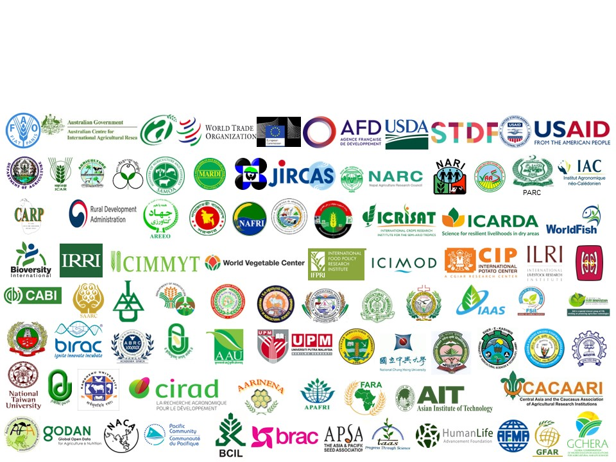

Our Partners

