Slide 1

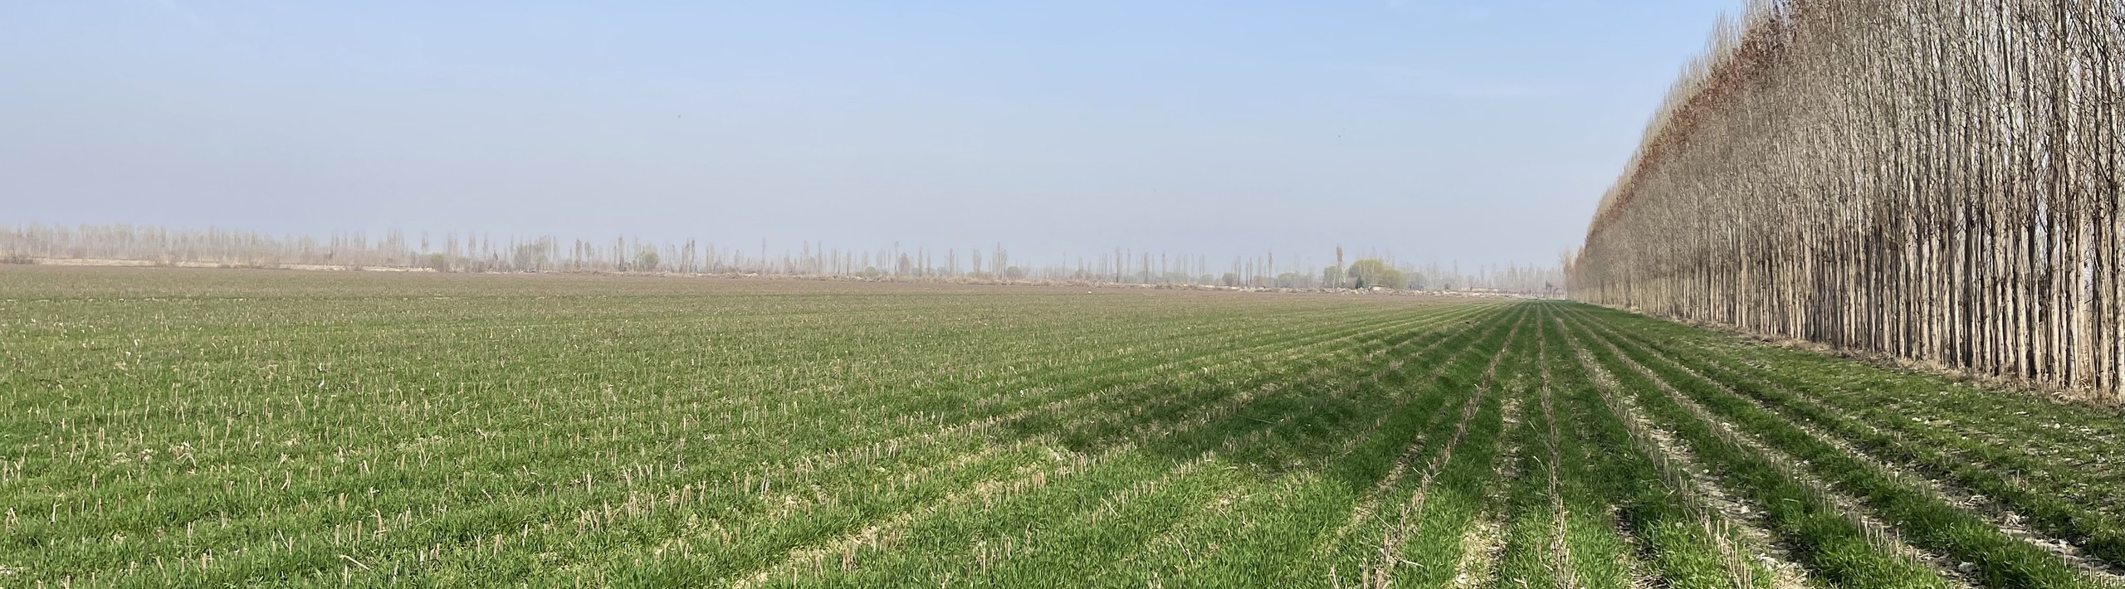
Central Asia and the Caucasus Association
of Agricultural Research Institutions
Agricultural research
through regional cooperation
Notes:
CACAARI brings national agricultural research institutions into a regional forum. Its purpose is to help institutions identify shared priorities and build the cooperation needed to address them. The landscape on the cover is from a field visit in Oltiarik, Fergana, Uzbekistan.

Slide 2
A regional forum for eight countries
National research institutions shape the regional agenda.
A wider research
and innovation
community
Kazakhstan
Georgia
Research institutes
Universities
Advisory services
Farmer organizations
Uzbekistan
Kyrgyzstan
Turkmenistan
Armenia
Azerbaijan
Tajikistan
Notes:
CACAARI works across Armenia, Azerbaijan, Georgia, Kazakhstan, Kyrgyzstan, Tajikistan, Turkmenistan and Uzbekistan. National institutions provide the expertise and mandate for regional cooperation. Cooperation connects the research community with advisory services and farmer organizations.

Slide 3
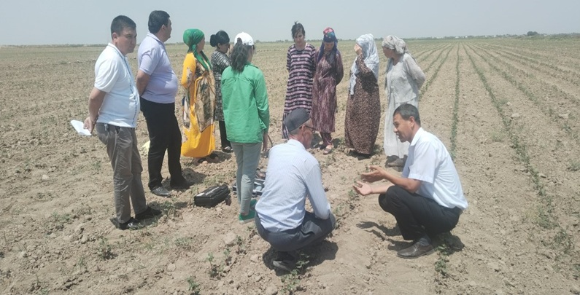



Shared challenges, complementary experience
Water and soils
Comparing approaches to irrigation,
salinity and soil management.
Climate adaptation
Sharing experience across dryland,
mountain and irrigated farming.
Food and rural livelihoods
Connecting research with crop choices,
nutrition and farm enterprise needs.
Field learning with farmers in Uzbekistan

Slide 4
National ownership of regional cooperation
CACAARI connects the institutions that define priorities with partners able to advance them.
National institutions
International partners
CACAARI
Research priorities
Scientific expertise
Farmers’ needs
Complementary expertise
Research collaboration
Programme resources
Shared priorities
Regional consultation
Partner coordination
A regional agenda gains value when institutions define it together
and remain responsible for the technical work.
Notes:
CACAARI provides a regional forum and a coordination function. Participating national institutions retain ownership of their priorities and lead the technical work. International partners contribute capabilities and resources within an agreed programme.

Slide 5
A two-way connection with farming
Research, education and advisory services work with farmers throughout the programme.
Needs and field feedback
Farmers and
advisory services
Research and
education
CACAARI
Consult and coordinate
Local knowledge
On-farm testing
Practical feedback
Joint research questions
Methods and evidence
Learning materials
Evidence and practical guidance
Notes:
Cooperation starts with consultation and continues through feedback. Researchers and educators contribute methods and evidence. Farmers and advisory actors help define needs, test relevance and identify improvements. CACAARI supports the relationships and coordination between these groups.

Slide 6
Experience in regional and global cooperation
2011–2014 | Regional research strategy and global engagement | Engaged eight countries in developing a regional agricultural research strategy.
2011–2018 | Agricultural information system (CAC-RAIS) | Established the CAC-RAIS hub to support agricultural research and innovation.
2013–2017 | YPARD forums | Established three national YPARD forums and facilitated the creation of a regional YPARD forum.
2014–2016 | Regional foresight hub | Established a regional hub for innovation foresight.
2014–present | Rural advisory services (CAC-FRAS) | Initiated CAC-FRAS to strengthen connections with rural advisory services.
2013–2014 (Phase I) | Women farmer programmes | Developed advisory services for women farmers.
2021–2024 (Phase II) | Women farmer programmes | Strengthened women farmers’ business and technical skills in cooperation with agricultural universities.
2024 | APAARI cooperation | Joint project development, knowledge exchange and capacity building.
2026 | AARINENA agreement | A partnership framework for joint research, training, advisory work and knowledge exchange.

Slide 7
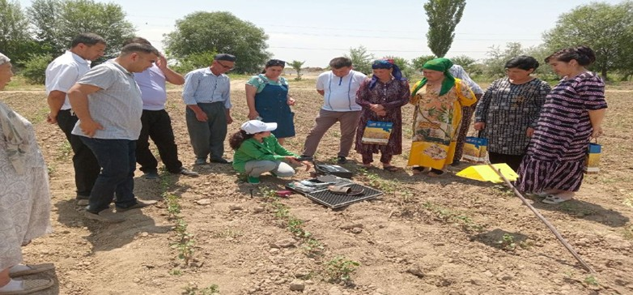
Research in the field
Experience from women farmer programmes in Uzbekistan
The task
Make research useful in farming
and agribusiness decisions.
CACAARI’s contribution
Connect university and extension
partners with participating farmers.
Concrete outputs
Soil testing, crop management and
practical learning with researchers
Field demonstrations, soil assessment
and feedback through visits and exchange.
With Tashkent State Agrarian University, RAESC and local research and advisory institutions

Slide 8



Cooperation across regions
Connecting the region with wider research and innovation communities
GFAiR
APAARI
AARINENA
Global dialogue and
collective action
Asia and the Pacific
Near East and
North Africa
Inclusive digital agriculture
and a regional contribution
to global research dialogue.
Joint projects, capacity building
and exchange, with a focus on
women and youth.
Research, training and advisory
cooperation through a signed
agreement in 2026.

Slide 9



Priorities for 2026–2030
Proposed focus for discussion with institutions and partners
Climate-resilient farming
Convene joint work on water use, soils and adaptation,
with comparable field evidence across countries.
Stronger research systems
Connect institutions around capacity needs,
research management and joint programmes.
Innovation with farmers
Link research, education and advisory services
through field learning with women farmers and youth.
Evidence and useful digital tools
Improve research indicators and assess digital tools
against institutional priorities and farmers’ needs.
Regional institutions define the priorities and participate in their delivery.

Slide 10
Concrete routes into a partnership
Joint product | CACAARI can contribute | Partners can contribute
A shared regional agenda | Institutional consultations and synthesis of priorities | National expertise and participation in dialogue
A joint programme concept | Partner connections, scope and coordination of roles | Technical design, delivery commitments and resources
A field learning programme | Links between research, education and advisory actors | Specialist methods, field sites and implementation
Evidence for planning | Regional dialogue on research capacity and information needs | Data expertise, national inputs and analytical collaboration
Each initiative starts with an agreed scope, responsibilities and resource plan.
Notes:
These are partnership products CACAARI can help develop. CACAARI’s contribution is convening and coordination, with technical work and resources agreed with participating institutions and partners. Each initiative would agree its delivery arrangements and resource plan with the participating organizations.

Slide 11

Opportunities for joint action
Proposed initiatives for co-development
Water and soils
across borders
Women and youth
in farm innovation
Evidence for
research investment
Research teams compare
water and soil methods across
farming systems.
Universities and farmer groups
work with advisory services on
practical learning.
Institutions and data partners
assess research capacity and
planning needs.
First deliverable
First deliverable
First deliverable
An agreed research question,
participating sites and a plan
for field learning.
Participant roles, field visits
and a feedback process in
a jointly designed pilot.
An indicator framework and
an initial assessment of
institutional capacity.

Slide 12
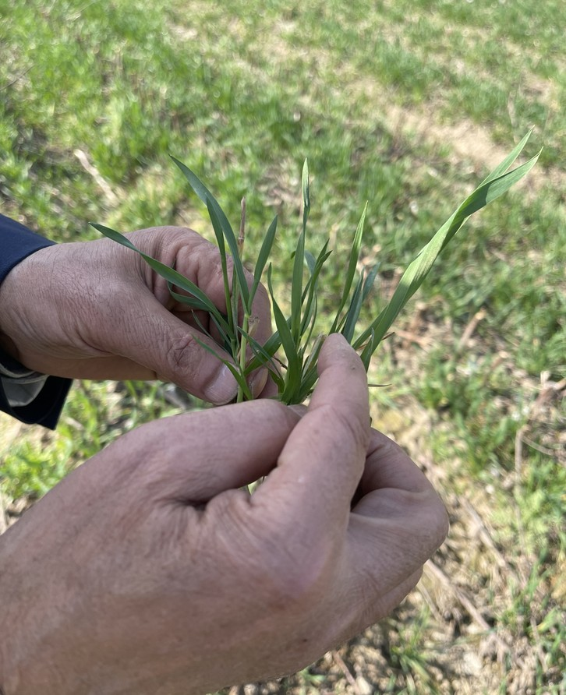
A clear basis for delivery and learning
Proposed approach for new joint programmes
An agreed purpose
A shared problem, intended users and a defined first result.
Named institutional roles
A technical lead, country responsibilities and a resource plan.
A practical learning process
Field learning and exchange, with structured feedback.
Evidence of progress
Follow up on delivery, participation and uptake.

Slide 13
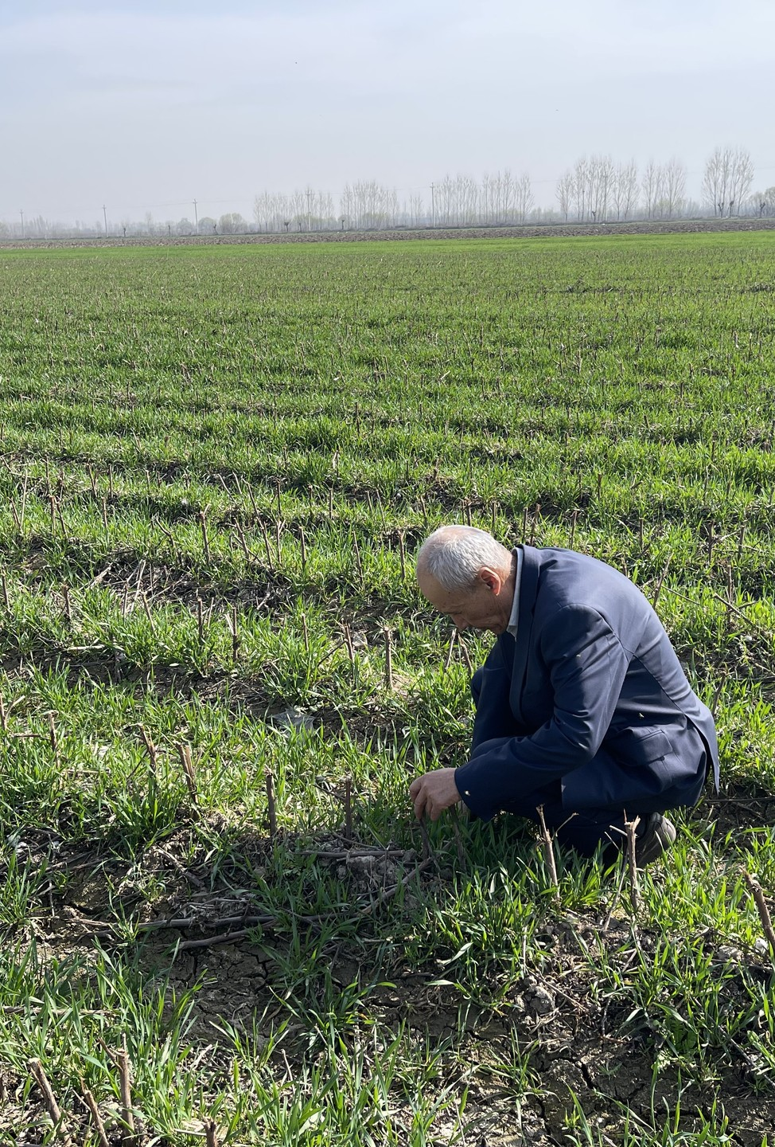
The value of
regional cooperation
National institutions
A voice in the regional agenda and access
to complementary research expertise.
Research and development partners
A way to shape relevant programmes
with institutions across the region.
Donors and programme partners
Priorities developed with national institutions
and opportunities for shared learning.
Farming communities
A stronger role in defining needs and
closer connections to research and advice.

Slide 14
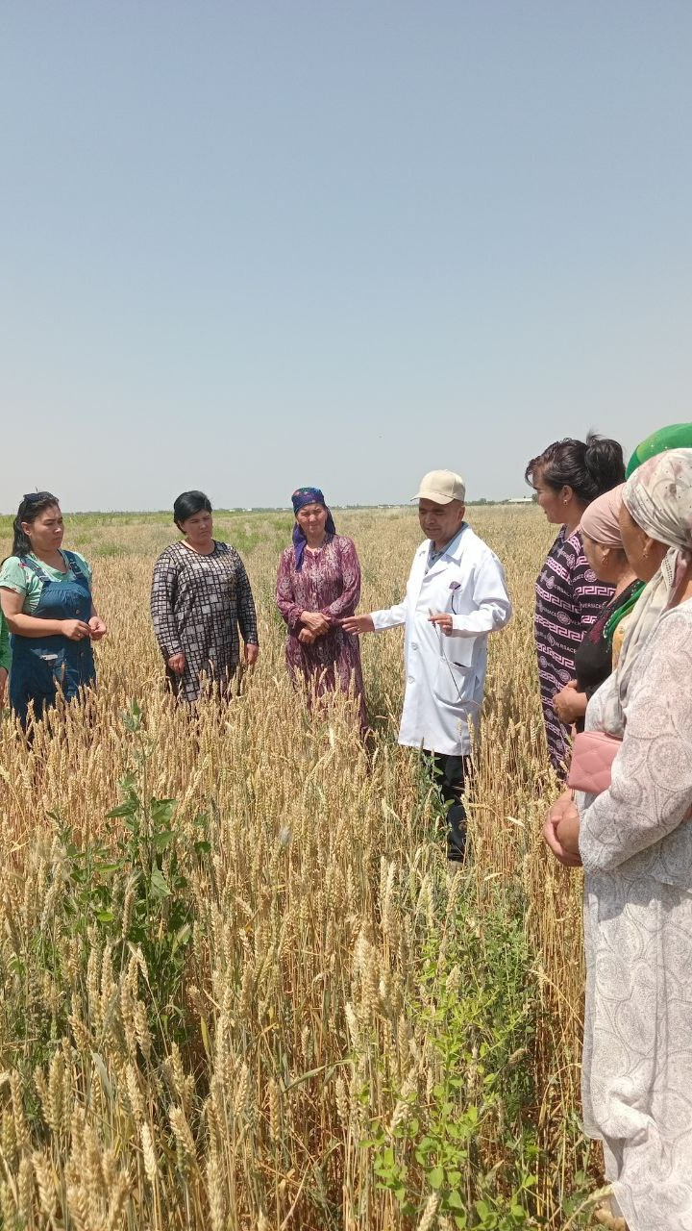
Working with
CACAARI
CACAARI connects national research institutions and systems with international partners to address shared agri-food challenges.
Dr. Botir Dosov
dosov.b@gmail.com
+998 94 674 80 57
Executive Secretary

