Slide 1

Forum of the Americas for Agricultural Research and Technology Development
FORAGRO
Reconceptualización
https://foragro.org/en

Slide 2

Forum of the Americas for Agricultural Research and Technology Development
It was established in 1997 as a hemispheric mechanism for dialogue and consensus-building on research and innovation issues affecting the agrifood sector across the Americas.
It is open and inclusive: producer organizations, civil society organizations, research and extension institutions, cooperation agencies, and all public, private, and academic organizations involved in agricultural research, development, and innovation (RDI) systems are eligible to register as members of its Assembly.

Slide 3

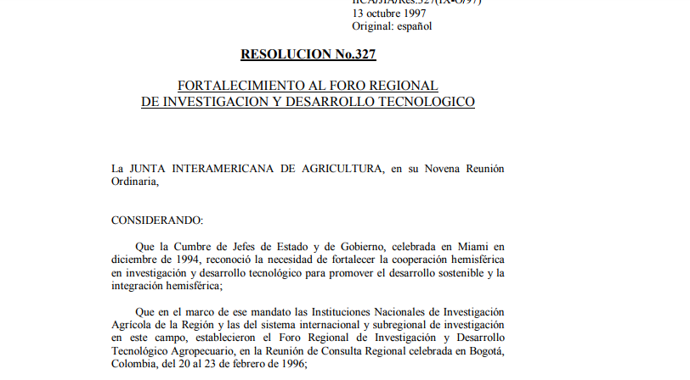
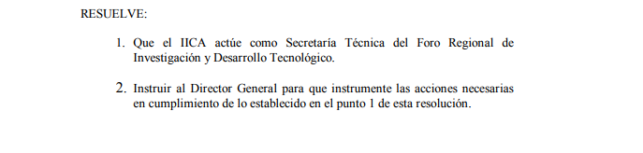

Creation
Established in 1997: Created by the Inter-American Board of Agriculture (IABA)
IICA’s role: Technical Secretariat
The IABA has repeatedly underscored FORAGRO’s role, contributions, and potential for cooperation, urging both its Member States and IICA to strengthen their engagement in the Forum. This call was reiterated at the IABA’s most recent meeting—the Twenty-second Regular Meeting—held in 2023.
FORAGRO has sought to consolidate this position and become the IABA’s technical arm on research, development, and innovation (R&D&I), a role that is crucial to strengthening the Forum’s legitimacy and political influence.
Notes:
Antecedentes y Logros Históricos
Establecimiento y Propósito Original:
Fundación en 1997: FORAGRO fue creado por la Junta Interamericana de Agricultura (JIA) para llenar el vacío de un espacio de discusión para una agenda conjunta de investigación agropecuaria en las Américas.
Función del IICA: El IICA fue facultado para ejercer la secretaría técnica, fortaleciendo así la participación de los Estados Miembros.
Logros Significativos:
Representación Internacional:
GFAR, CGIAR, GCARD: FORAGRO ha representado a las Américas en importantes foros globales de investigación agrícola.
Reuniones Hemisféricas:
Ocho Reuniones: Organización de ocho reuniones hemisféricas sobre Investigación e Innovación Agropecuaria para el Desarrollo.
INFOTEC:
Plataforma Tecnológica: Lanzamiento de INFOTEC, una plataforma utilizada por más de 22,000 usuarios para acceder a información tecnológica en CTi agropecuaria.
Acuerdos de Cooperación:
Alianzas Regionales: Realización de acuerdos con organizaciones como el PARLATINO.
Publicaciones Técnicas:
Documentos de Prospectiva: Publicación de documentos técnicos sobre prospectiva tecnológica en la agricultura.

Slide 4
Nature of the Forum:
“What It Is” and “What It Has Done”
The Forum has focused on strengthening its work on two fronts:
Internally: fostering a space for dialogue; facilitating exchange and coordination among public- and private-sector actors within the regional system; advocating for greater investment; and building a shared vision and a hemispheric agenda.
Externally: building strategic partnerships and significantly deepening engagement with leading regional and global institutions, in coordination with GFAiR, the Regional Fora, and CGIAR.
Sub-Regional, Regional y Global Cooperation
Notes:
Antecedentes y Logros Históricos
Establecimiento y Propósito Original:
Fundación en 1997: FORAGRO fue creado por la Junta Interamericana de Agricultura (JIA) para llenar el vacío de un espacio de discusión para una agenda conjunta de investigación agropecuaria en las Américas.
Función del IICA: El IICA fue facultado para ejercer la secretaría técnica, fortaleciendo así la participación de los Estados Miembros.
Logros Significativos:
Representación Internacional:
GFAR, CGIAR, GCARD: FORAGRO ha representado a las Américas en importantes foros globales de investigación agrícola.
Reuniones Hemisféricas:
Ocho Reuniones: Organización de ocho reuniones hemisféricas sobre Investigación e Innovación Agropecuaria para el Desarrollo.
INFOTEC:
Plataforma Tecnológica: Lanzamiento de INFOTEC, una plataforma utilizada por más de 22,000 usuarios para acceder a información tecnológica en CTi agropecuaria.
Acuerdos de Cooperación:
Alianzas Regionales: Realización de acuerdos con organizaciones como el PARLATINO.
Publicaciones Técnicas:
Documentos de Prospectiva: Publicación de documentos técnicos sobre prospectiva tecnológica en la agricultura.

Slide 5





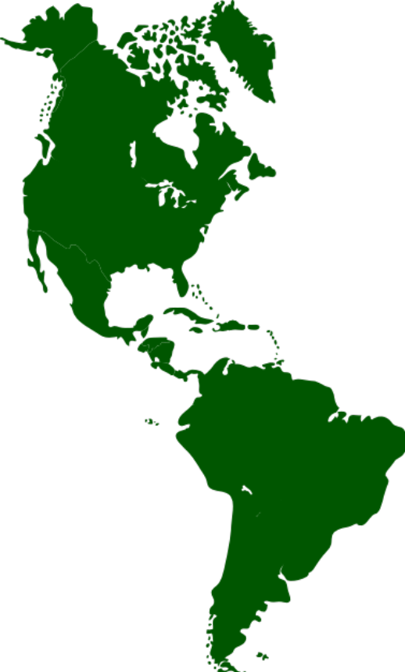

















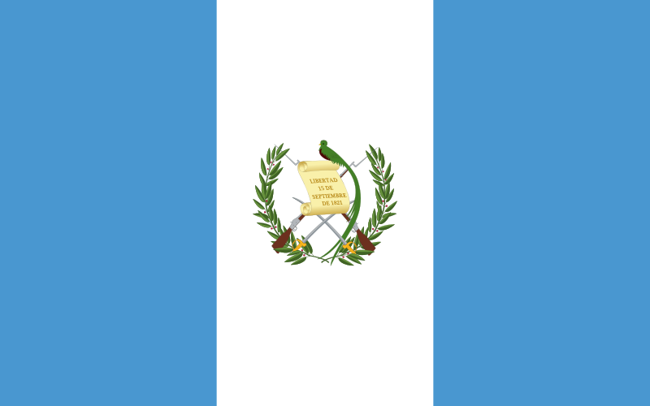


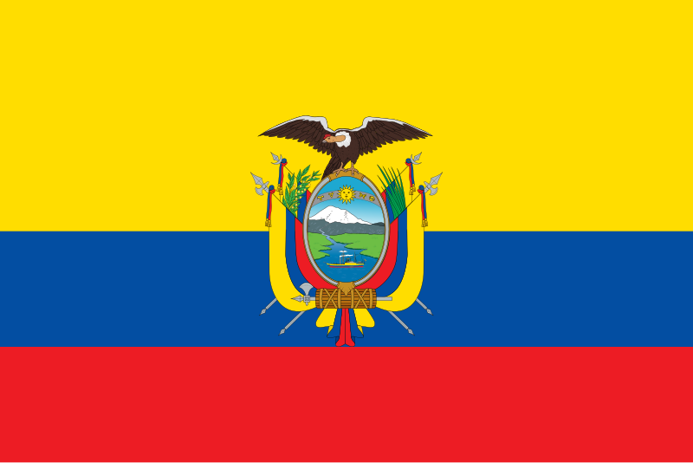
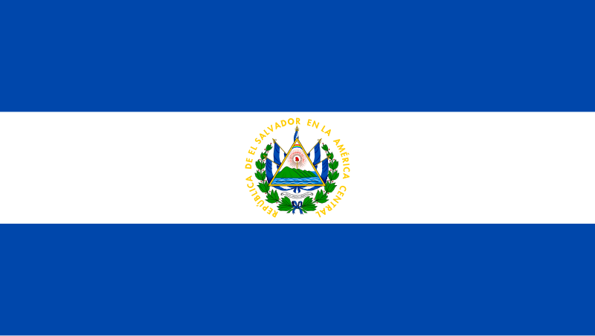



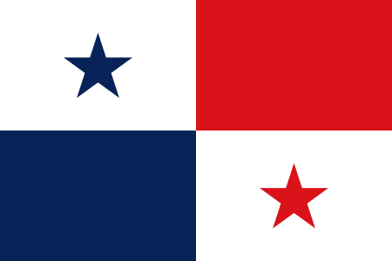










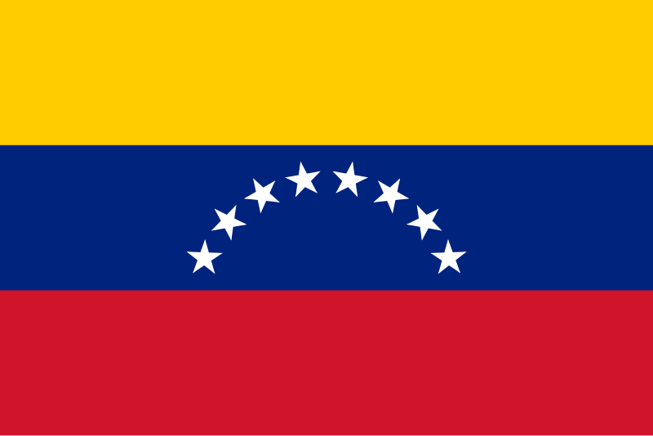
AGROFOODTROP
Networks
Networks
INIAs IBEROAMERICA
National Innovation Systems
Notes:
Antecedentes y Logros Históricos
Establecimiento y Propósito Original:
Fundación en 1997: FORAGRO fue creado por la Junta Interamericana de Agricultura (JIA) para llenar el vacío de un espacio de discusión para una agenda conjunta de investigación agropecuaria en las Américas.
Función del IICA: El IICA fue facultado para ejercer la secretaría técnica, fortaleciendo así la participación de los Estados Miembros.
Logros Significativos:
Representación Internacional:
GFAR, CGIAR, GCARD: FORAGRO ha representado a las Américas en importantes foros globales de investigación agrícola.
Reuniones Hemisféricas:
Ocho Reuniones: Organización de ocho reuniones hemisféricas sobre Investigación e Innovación Agropecuaria para el Desarrollo.
INFOTEC:
Plataforma Tecnológica: Lanzamiento de INFOTEC, una plataforma utilizada por más de 22,000 usuarios para acceder a información tecnológica en CTi agropecuaria.
Acuerdos de Cooperación:
Alianzas Regionales: Realización de acuerdos con organizaciones como el PARLATINO.
Publicaciones Técnicas:
Documentos de Prospectiva: Publicación de documentos técnicos sobre prospectiva tecnológica en la agricultura.

Slide 6





















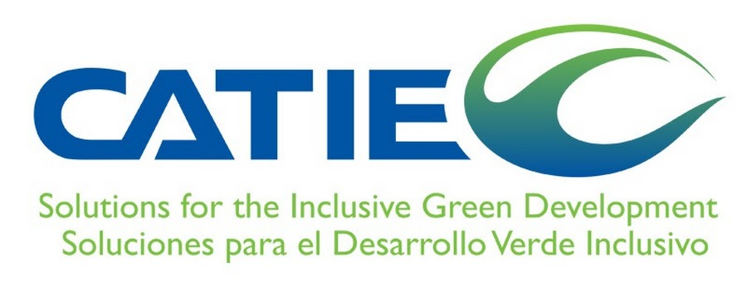

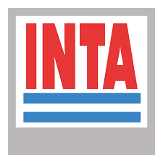
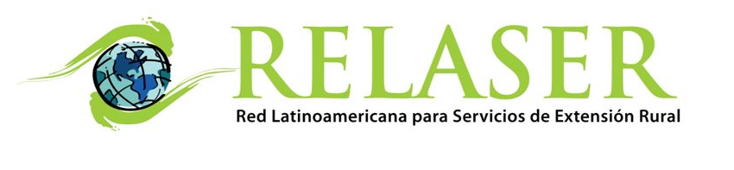
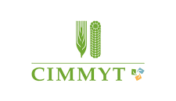



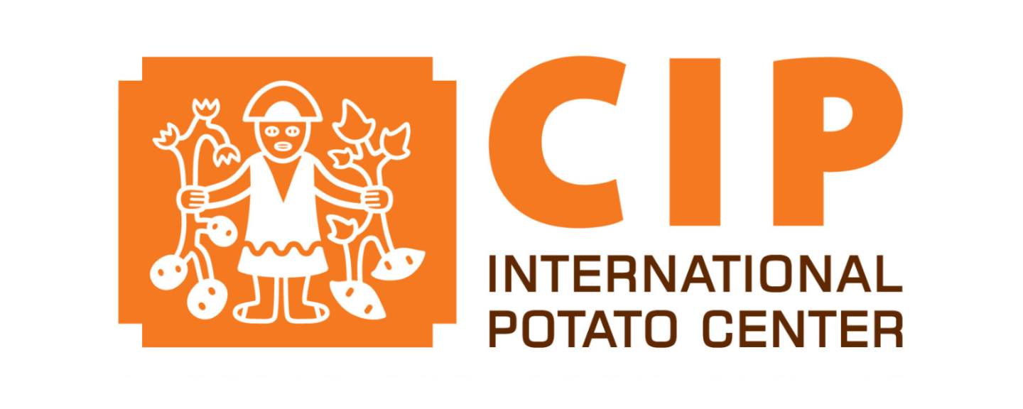
FORAGRO Membership
Conexión con Iniciativas Globales
Defensa de la Inversión en I&D
Participación en Iniciativas Globales
Intercambio Internacional
Junta Interamericana de Agricultura (JIA)
ASTI
Regional cooperation mechanisms for research, development, and innovation (R&D&I)
Academic institutions
Stakeholders from agricultural production systems
Civil society organizations
Organizations that promote and support R&D&I
Agricultural extension systems and rural service providers
Discussion forums focused on R&D&I
Intergovernmental organizations
IICA
Notes:
Lo más importantes actores regionales en Ciencia, Tecnología e Innovación para los Sistemas Agroalimentarios hacen parte de FORAGRO. Alianza de Bioversity International & CIAT, CATIE, CGIAR-ALC, CIMMYT, CIP, Consejo Agropecuario Centroamericano CAC-SICA, FONTAGRO, IFPRI, IICA, Institutos Nacionales de Investigación Agropecuaria (INIAs), PROCINORTE, PROCISUR, PROMECAFE, Red Innovagro, YPARD, entre otros

Slide 7








FORAGRO - A hemispheric forum that has actively engaged in global platforms such as GFAiR and CGIAR, providing the Americas with a representative and legitimate voice.
Regional Fora
Interregional Cooperation (South–South and South–South–North)
Notes:
Antecedentes y Logros Históricos
Establecimiento y Propósito Original:
Fundación en 1997: FORAGRO fue creado por la Junta Interamericana de Agricultura (JIA) para llenar el vacío de un espacio de discusión para una agenda conjunta de investigación agropecuaria en las Américas.
Función del IICA: El IICA fue facultado para ejercer la secretaría técnica, fortaleciendo así la participación de los Estados Miembros.
Logros Significativos:
Representación Internacional:
GFAR, CGIAR, GCARD: FORAGRO ha representado a las Américas en importantes foros globales de investigación agrícola.
Reuniones Hemisféricas:
Ocho Reuniones: Organización de ocho reuniones hemisféricas sobre Investigación e Innovación Agropecuaria para el Desarrollo.
INFOTEC:
Plataforma Tecnológica: Lanzamiento de INFOTEC, una plataforma utilizada por más de 22,000 usuarios para acceder a información tecnológica en CTi agropecuaria.
Acuerdos de Cooperación:
Alianzas Regionales: Realización de acuerdos con organizaciones como el PARLATINO.
Publicaciones Técnicas:
Documentos de Prospectiva: Publicación de documentos técnicos sobre prospectiva tecnológica en la agricultura.

Slide 8


FORAGRO’s Strategic Areas of Work
AXIS 1
AXIS 2
AXIS 3
Strategic Roadmap and Foresight for Agrifood Science, Technology, and Innovation (STI)
Platform for Horizontal Cooperation
Strategy for Engagement with International STI Platforms

Slide 9
AXIS 1: Strategic Roadmap and Foresight in Science, Technology, and Innovation (STI)
1
2
3
4
5
6
Scope Definition
Baseline
Vision and Goals
Innovation Pathways
Support Instruments
Governance and Key Innovations
Definition of the global context and the role of the “Mission” in driving productive or social transformation.
Development of:
Impact maps (problem areas)
Innovation map
Policy maps
Establishment of:
A shared vision
Main and intermediate objectives
Goals
An agreed time horizon for the roadmap
Definition of:
Key innovations for the mission
Portfolio of research and innovation projects
Mission-enabling systems
Risks to the development of the mission
Definition of:
A portfolio of mission-oriented policies
An action plan for implementing the long-term policy roadmap, including its objectives, goals, and plans, as well as the sequencing of instruments to be led by public- and private-sector stakeholders over the short, medium, and long term
Definition of:
A governance structure for the roadmap—for example, a committee or commission
Metrics for monitoring and evaluating roadmap implementation (indicators)
Budgets and actions dedicated by key stakeholders to supporting the roadmap
The entire methodological process will be supported by FORAGRO’s Technical Advisory Group, comprising the Executive Secretariats of FONTAGRO, PROCISUR, and PROCINORTE; the INNOVAGRO Network; the CAC-ITI Technical Group; and PROMECAFÉ.

Slide 10

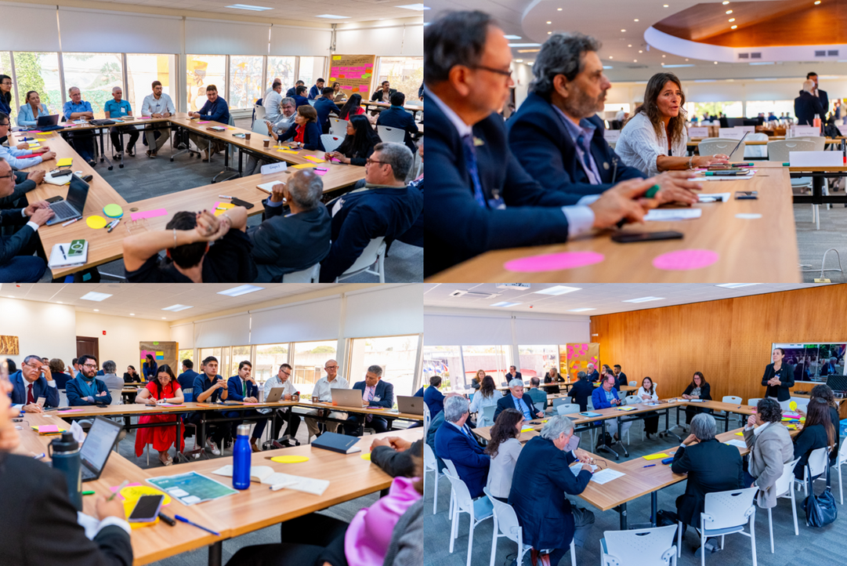
AXIS 1: Strategic Roadmap and Foresight in Science, Technology, and Innovation (STI)
In-person workshop held as part of the Second Regional Dialogue on Science, Technology, and Innovation for Agrifood Systems
Identification of priority thematic areas based on the workshop’s inputs
Analysis of secondary evidence using artificial intelligence tools
Workshop with FORAGRO members to develop the narrative framing of the challenge and define the mission objective
Identification of 121 problems, grouped into five thematic categories

Slide 11


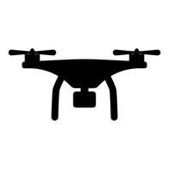


AXIS 1: Strategic Roadmap and Foresight in Science, Technology, and Innovation (STI)
5 Main Problem Categories
Limited capacity of the agricultural sector to adapt to a changing context
Low productivity and efficiency across agrifood systems
A widening rural digital divide that hinders the adoption of advanced agricultural technologies and informed decision-making
Limited integration of the bioeconomy and underutilization of biodiversity and biomass in agrifood systems
Weak institutional and regulatory coordination for promoting sustainable innovation and the bioeconomy across agrifood systems in the Americas
Notes:
4

Slide 12




AXIS 1: Strategic Roadmap and Foresight in Science, Technology, and Innovation (STI)
Baseline
Science Intelligence and Policy Analysis
59.565 scientific articles
559 policy and support instruments for science, technology, and innovation across 23 countries in the región,
Bibliometric análisis
Text mining
Impact Map and 10 Innovation Pathways

Slide 13
AXIS 2: Platform for Horizontal Cooperation
1
2
3
Strategic Assessment of Needs and Capacities
Technical and Functional Design of the OPSAa Platform
Operation of the AGROFOOD-TROP Platform
IICA–CATIE–Alliance of Bioversity International and CIAT–EMBRAPA–CARDI - CIRAD
Implementation of the platform, including:
Research project pipeline
Tropical Agriculture Conference
Resource mobilization
Bioentrepreneurship Center
Policy brief
Strengthening of the AGROFOOD-TROP Secretariat
Mapping and prioritization of the region’s shared needs in agrifood science, technology, and innovation (STI)
Identification and characterization of existing initiatives, networks, and capacities
A Science, Technology, and Innovation section is now available within OPSAa.
It includes policies, resources, and strategies for the governance and management of science, technology, and innovation in agrifood systems.

Slide 14
AXIS 2: Platform for Horizontal Cooperation
OPSAa Intelligent Information Manager
An artificial intelligence–based solution designed to streamline the retrieval, organization, and comparison of information relevant to decision-making in science, technology, and innovation (STI). Powered by artificial intelligence (AI).
Internal OPSAa Module
External Module
Workshops with NARIs and Research Centers of Excellence: definition of criteria and prioritization of topics.
Information extraction
Information processing
Generation of technology profiles
Public policy comparison
Designed to support National Agricultural Innovation Institutes (NARIs) and other regional stakeholders.
Compares and analyzes only the information uploaded to the platform, ensuring that results are reliable and up to date.
OPSAa Bot
Asynchronous exercises: co-creation of criteria and identification of information sources, helping stakeholders harness new frontiers in STI.
Automatic retrieval of documents from repositories, websites, and other reliable sources.
Optimizes time and resources while improving institutional efficiency and agility in information management.

Slide 15
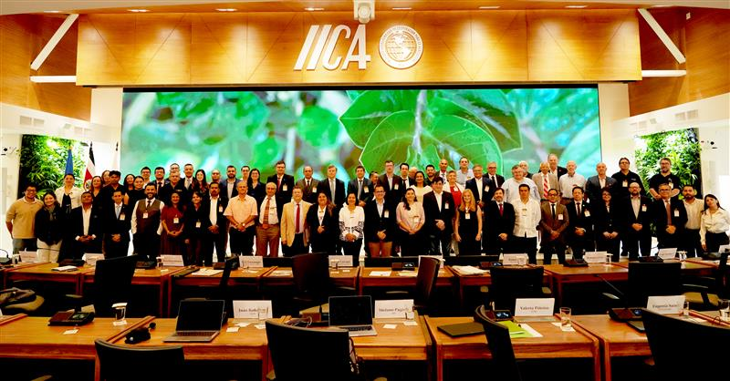
AXIS 2: Platform for Horizontal Cooperation
Agrofood-Trop Iniciative
CATIE-IICA-EMBRAPA-CARDI-Alianza Bioversity CIAT - CIRAD
Tropical Agriculture Plataform
RESEARCH AGENDA
Pipeline of development and research projects
Proposal to strengthen the National Agricultural Innovation Institutes (NARIs)
Proposal for a new agricultural extension model
ROAD MAP
KNOWLEDGE MANAGEMENT
Tropical Agriculture Conference
PUBLIC POLICIES
80
230
Tropical Agriculture section within OPSAa, powered by AI
RESOURCE MOBILIZATION
Participants
Private sector: pineapple producers, livestock producers, coffee growers, horticultural producers, and banana producers
Academia
Public sector
Banks, investment funds, and development finance institutions
Views and Social Media
Inventory of high-impact tropical innovations

Slide 16
AXIS 3: Strategy for Engagement with International STI Platforms
1
2
3
FORAGRO as a Strategic Foresight Radar for Global STI Trends
FORAGRO as a Strategic Mapper and Interpreter of International STI Arenas
FORAGRO as the Architect and Voice of a Forward-Looking Regional Agenda and Narrative
A matrix and strategic profiles of key international agrifood STI platforms, including an analysis of opportunities, relevant stakeholders, and regional representation
A foresight report analyzing emerging agrifood trends and their implications for Latin America and the Caribbean (LAC), translating them into regional strategic priorities and providing recommendations for decision-makers and agrifood innovation stakeholders
Strategic support for FORAGRO spokespersons to position regional priorities on global agendas through unified messaging and coordinated proposals

Slide 17
AXIS 3: Strategy for Engagement with International STI Platforms
Regional Working Group on Technology Foresight
Promote the exchange of knowledge, experience, and tools related to emerging technologies and strategic trends, thereby fostering a shared vision for the future of science and technology in support of agricultural development across the Americas.
18
9
Allbiotech, CATIE, CIMMYT, DICTA, Embrapa, FIA, FHIA, FONTAGRO, IDIAF, ILSI Mesoamerica, INIA Chile, INIAP, MAFSE, NMSU, PDRR, RELASER, UNAG, YPARD.
Belize, Brazil, Chile, Costa Rica, Ecuador, Honduras, Mexico, Panama, Dominican Republic
FORAGRO Members
Countries

Slide 18
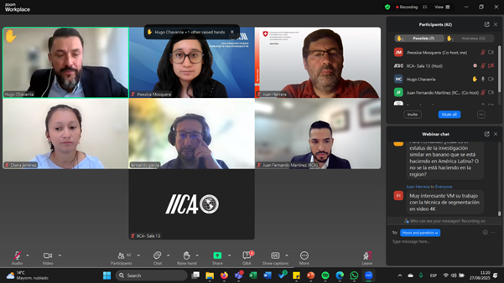
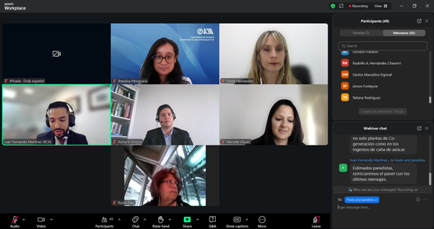
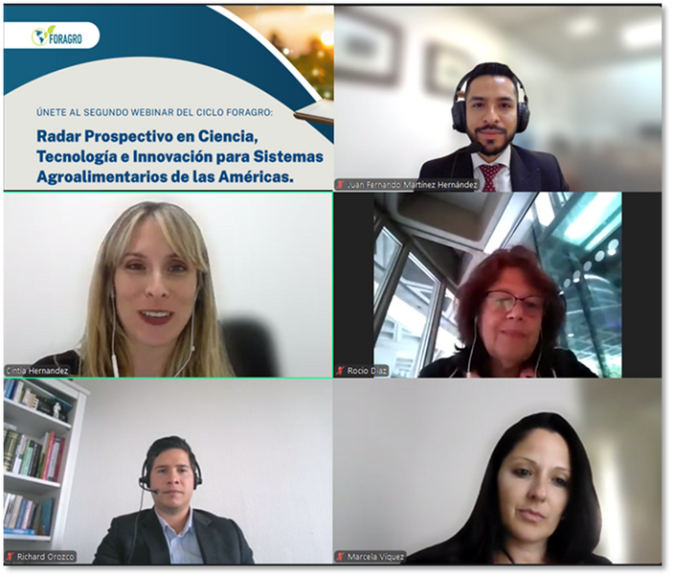
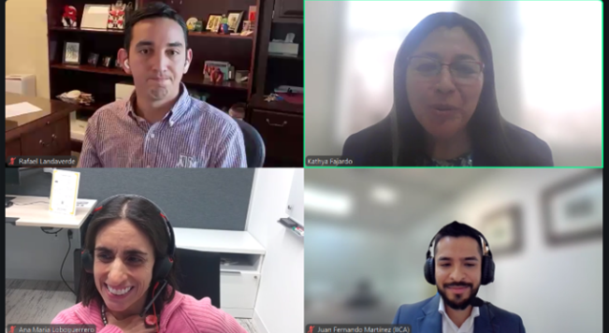
AXIS 3: Strategy for Engagement with International STI Platforms
1
2
170 Participants in Webinars Organized by FORAGRO’s Foresight Group
Productivity and efficiency in agrifood systems
Adaptation of agrifood systems to a changing context
Bioeconomy and the sustainable use of biodiversity and biomass in agrifood systems
3
Adaptation of agrifood systems to a changing context

Slide 19








AXIS 3: Strategy for Engagement with International STI Platforms
FORAGRO’s Foresight Group webinars have featured 8 members of the Latin American diaspora working at leading institutions.

Slide 20
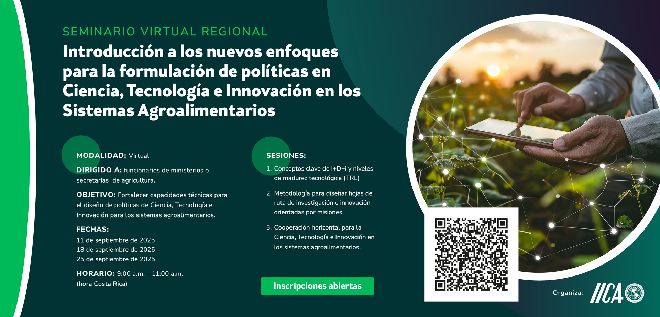
AXIS 3: Strategy for Engagement with International STI Platforms
Participation of Members of the Regional Working Group on Technology Foresight

Slide 21

AXIS 3: Strategy for Engagement with International STI Platforms
Assessing the Culture of Impact and Showcasing Success Stories in Agricultural R&D across the Hemisphere
Opening date: June 23, 2025
Closing date: August 4, 2025
46 cases received
23 countries represented

Slide 22
In Summary
Well-established positioning at both regional and global levels
Strong capacity for strategic reflection and the development of renewed proposals
Progressive institutional development and strong commitment among internal and external stakeholders, with tangible achievements that capitalize on economies of scale and scope
Adds value to national and subregional efforts
FORAGRO “is an organization that has built significant strategic assets that should be sustained and further developed”
Notes:
Antecedentes y Logros Históricos
Establecimiento y Propósito Original:
Fundación en 1997: FORAGRO fue creado por la Junta Interamericana de Agricultura (JIA) para llenar el vacío de un espacio de discusión para una agenda conjunta de investigación agropecuaria en las Américas.
Función del IICA: El IICA fue facultado para ejercer la secretaría técnica, fortaleciendo así la participación de los Estados Miembros.
Logros Significativos:
Representación Internacional:
GFAR, CGIAR, GCARD: FORAGRO ha representado a las Américas en importantes foros globales de investigación agrícola.
Reuniones Hemisféricas:
Ocho Reuniones: Organización de ocho reuniones hemisféricas sobre Investigación e Innovación Agropecuaria para el Desarrollo.
INFOTEC:
Plataforma Tecnológica: Lanzamiento de INFOTEC, una plataforma utilizada por más de 22,000 usuarios para acceder a información tecnológica en CTi agropecuaria.
Acuerdos de Cooperación:
Alianzas Regionales: Realización de acuerdos con organizaciones como el PARLATINO.
Publicaciones Técnicas:
Documentos de Prospectiva: Publicación de documentos técnicos sobre prospectiva tecnológica en la agricultura.

