Slide 1
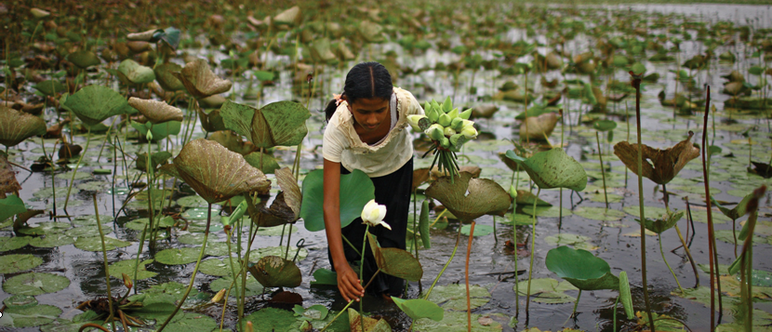
A review of the Global Conference on Agricultural Research for Development
(GCARD): An analysis of the way forward
Dr. Rodney D. Cooke
April 2013

Slide 2
The key strategic objectives of the Global Forum on Agricultural Research (GFAR Annual Report 2010) are:
Advocacy for change through agricultural research to meet the future needs of humanity
Reshaping institutions for the future to link agricultural science and society
Increasing ARD effectiveness by fostering inter-regional partnership and learning
Bridging the knowledge gaps and enabling the poor to access critical knowledge to empower their own innovation and development.

Slide 3
GFAR AIM to transform and strengthen all aspects of agricultural innovation systems to achieve:
Better priority setting and advocacy for agricultural research, responding to key challenges and development needs around the world
Better partnerships and synergies between different sectors and institutions in agricultural research-for-development (AR4D) systems, with farmers at the centre of these processes
Institutions and their capacities transformed to meet the needs of today – and tomorrow
Funding systems are aligned between research and development;
Sharing and scaling-out of new knowledge and learning of all forms to foster change and innovation.

Slide 5
The CGIAR observed in the SRF (2011) that it looked to GCARD 2 :
‘ to (i) take, together with partners and other stakeholders, a critical look at the current portfolio of CRPs and identify possible adjustments needed, and
(ii) formally undertake a first approach at the monitoring and feedback from the partnering strategies through which they are implemented’.

Slide 6
Much positive feedback after GCARD2
80% of respondents found the sessions to have been either useful or very useful to their work
79% felt that the knowledge acquired is likely to change the design or implementation of their AR4D programmes and activities.
83% found the partnership sessions either useful, or very useful, to their work.
GCARD2 also led to a range of fifteen commitments to partnership, capacity development and foresight in the CGIAR, Frank Rijsberman, CGIAR Consortium CEO.

Slide 7
But major concerns were also expressed that need attention looking forward
as a costly operation, GCARD needs more focus
National AR4D views did not receive enough attention
how to increase the utility of GCARD to promote effective interaction with CGIAR stakeholders and partners in CRPs?
Fund Council: concerns about effectiveness and efficiency of GCARD

Slide 8
The key messages emerging are brought together in grouped questions (section III):
National and regional views well represented?
Balance of participants at the Conference?
Was the process leading up to GCARD effective?
Was GCARD useful to improve CRP research partnerships?
The balance between research partnership and development partnership (uptake pathways)?
Was the time used to best effect?
Preparation and organization of the event should have been better?

Slide 9
Please indicate which category of GFAR stakeholder corresponds most closely to you:

Slide 10
The thematic balance of the presentations and discussions in the plenary and break-out sessions was:

Slide 11
Please indicate your view of the balance of participation of the AR4D stakeholders at GCARD 2, by selecting one of the options for each of the 7 stakeholder types in the table below:
Answer Options | Participation just right | Over-represented | Under-represented | Response Count
Farmer, farmers' organization | 30 | 3 | 76 | 109
CSO, NGO | 53 | 16 | 40 | 109
Private sector | 38 | 4 | 66 | 108
Public sector AR4D organization in the developing world | 57 | 11 | 41 | 109
Public sector AR4D organization in OECD country | 64 | 28 | 14 | 106
CGIAR staff, IARCs | 63 | 41 | 5 | 109
Donor, bilateral or multilateral | 69 | 9 | 29 | 107

Slide 12
The representation of regional and national AR4D participants at GCARD should include more development partners

Slide 13
CRP partnership sessions focused primarily on research priorities, and that more emphasis should have been given to uptake pathways and development partners?
Notes:
Note now talking about climate deal, not necc at Copenhagen
"I have heard representatives of both Europe and the US say that the target that China has tabled can be improved upon; I have heard representatives from Europe and China say that the target tabled by the US can be improved upon ... and I have heard least developed states say that nobody's targets are good enough at the moment," de Boer said.
UNEP/Stern research estimates that in order to have a reasonable chance, or 50 per cent probability, of avoiding a rise in global temperature of more than 2˚C, annual global emissions of greenhouse gases in 2020 need to be no more than 44 billion tonnes of carbon-dioxide-equivalent.
The analysis shows that the gap between this target and the most ambitious cuts proposed by countries over the past months and weeks is about 2 billion tonnes of carbon-dioxide-equivalent, with a range of 1 to 5 billion tonnes. If the overall target 44 billion tonnes is exceeded in 2020, it is likely to be more difficult and costly to reach the goal as much stronger action would be required in decades afterwards.
FINANCE
Developing nations have said the rich should devote far more money to helping them combat climate change and adapt to shifts such as more droughts, floods and rising seas. African nations, for instance, say $267 billion a year will be needed from 2020.
The European Union has said that developing nations will need 100 billion euros a year from 2020. About 22-50 billion euros of the total will come from the public purse worldwide and the EU will provide a fair share. Many other developed nations have not made such clear offers.
The United Nations wants $10 billion a year on the table in Copenhagen to help kick-start a deal. Developed nations have yet to come up with cash.
OVERSEEING FUNDS
Delegates are considering various mechanisms to oversee funds and balance the interests of donors and recipients. Developed countries favour some World Bank supervision, and developing nations prefer the U.N. climate secretariat.
THE KYOTO PROTOCOL
Many developed nations suggest that the existing Kyoto Protocol, which binds all industrialised nations except the United States to curb emissions by 2012, could be merged with a parallel track trying to agree obligations for all nations. Developing nations say a merger would risk "killing" Kyoto since many of them do not want obligations on the same level as those imposed on developed nations.
KYOTO
Other gaps remaining in talks to extend the Kyoto Protocol:
* A base year against which to compare emissions cuts in 2020; countries have proposed these base years -- 1990, 2000, 2005 and 2006. * Length of the next period of the Kyoto Protocol after the present 2008-2012 period; countries have proposed: 2013-2017; 2013-2020; and 2013-2017 followed by 2018-2022.
* How to account for forests, which suck carbon from the air; depending on how to include forests, greenhouse gas emissions targets will look completely different.
* What new gases to include, in addition to the six greenhouse gases currently included in the Kyoto Protocol.
Whether to increase a levy on carbon markets, to raise funds to pay for adaptation to climate change in developing countries.
A beacon to guide discussions is the Intergovernmental Panel on Climate Change’s finding that an aggregate emission reduction by industrialised countries of between minus 25% and 40% over 1990 levels would be required by 2020, and that global emissions would need to be reduced by at least 50% by 2050, in order to stave off the worst effects of climate change.

Slide 14










New Impacts on Development Problems to Research Output
Assess
Wider development impacts on food security, environmental sustainability, poverty alleviation
Monitor and Evaluate
Measurable targets for direct development impact from Programs. Derived from our collaborative work with partners
Intent
Measurable Program targets for research and development outcomes.
Responsibility
Accountability
Deliver
Measurable output targets from Programs

Slide 15
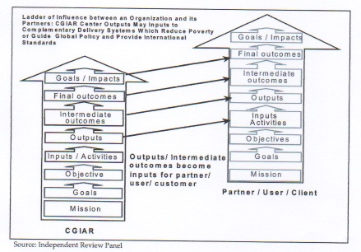

Slide 16
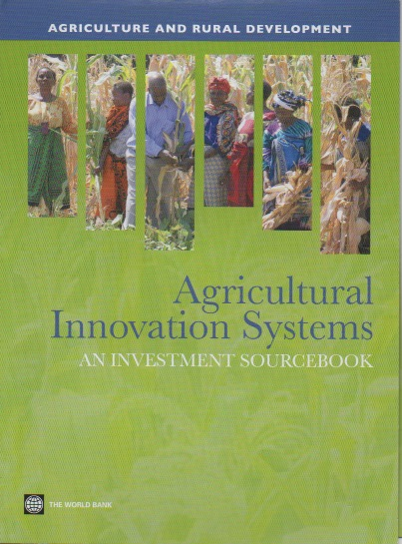
Agricultural Innovation Systems
An investment sourcebook ( WB 2012)
Agricultural innovation system includes :
Consumers
Agroprocessors
Exporters
Producer organizations
Input suppliers
Standards agencies
National agricultural research system
Farmers – other entrepreneurs
Farmers
National education and training organizations
Bridging and coordination organizations
National extension and business development services
Land agencies
Credit agencies
Government policy and regulatory framework
Informal institutions, practices, and behaviors

Slide 17
V.1 A sharper definition of the GCARD partnership focus, its interaction with national partners, and an accountability mechanism for the CGIAR SRF and CRPs
The GCARD partnership focus
Recommendation 1 - The GCARD partnership theme should focus to a greater extent than in GCARD 2 on research uptake pathways: partnership with the agricultural development community.
The GCARD interaction with national partners
Recommendation 2 - The reformed and smaller GCARD Organizing Committee should draw more directly on the on-going national and regional programmes in designing the Conference. That Committee also needs to oversee the changed balance of participation comprising Recommendation 5, below.
An accountability mechanism for the CGIAR SRF and CRPs
Recommendation 3 - The GCARD focus should include providing an accountability mechanism for CG SRF and CRPs to stakeholders, as described in Section IV 1 3.
17

Slide 18
More time available in the sessions (both plenary or breakout sessions) is needed for discussion and interaction and less for the formal presentations /PWPs

Slide 19
For greater impact on the GCARD agenda and outcomes, (Pre-) Conference events should have been preceded by preparatory meetings and discussions in the regions

Slide 20
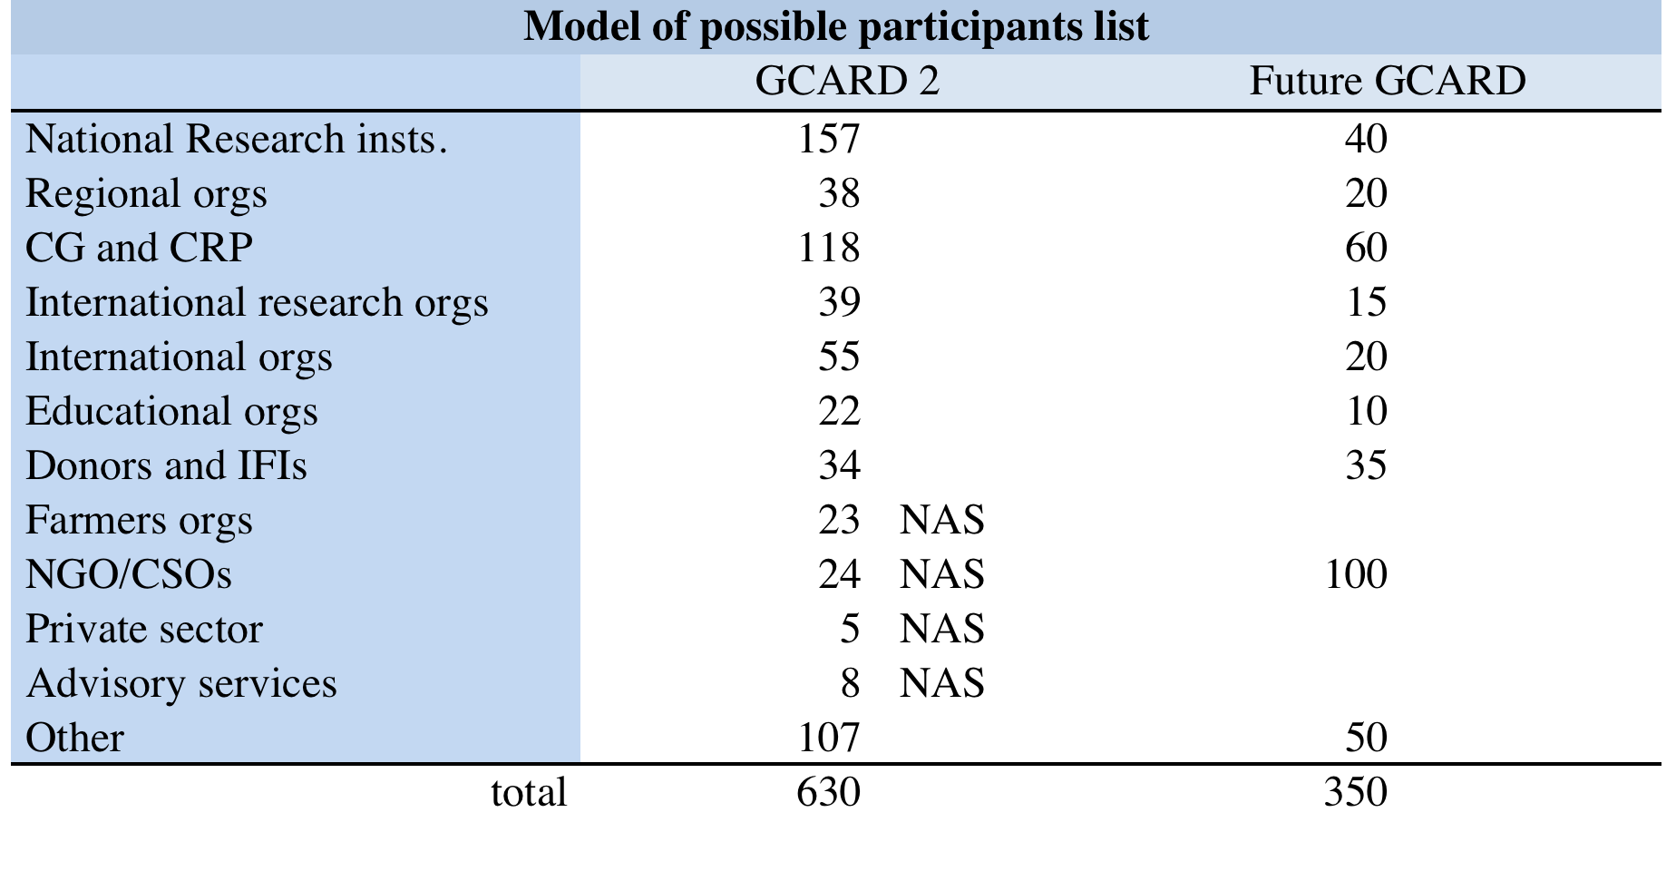

Slide 21
National and regional views on foresight, partnership and capacity development were well represented

Slide 22
V.2 A clearer set of mechanisms to deliver the GCARD process in the 2 year period between the GCARD Conferences
Recommendation 4 - The GCARD joint venture between GFAR and CGIAR should organize this two-year process more effectively, embodying this in the forthcoming SRF Action Plan and the GFAR MTP, in order to have a more focused, effective and efficient GCARD Conference
V.3 The design of a smaller and more efficient GCARD Conference
Recommendation 5 - The GCARD Conference should involve a larger proportion of rural development practitioners in a smaller more efficient meeting, which articulates with the two year preparatory processes described above.

Slide 23
V.4 Organize and structure the Conference to optimize networking and effective communication
Recommendation 6 - The GCARD Organizing Committee to adopt the principles demanded in section III involving longer term planning and organization in the 6 month period prior to the Conference, and the design of an interactive 3-day Conference which alternates half day sessions on national/regional priorities and reports with half day sessions on CGIAR SRF/CRP perspectives and reports. This would set the context for the Funders Forum and the interaction between the CGIAR and its investors.
V.5 Locating the Conference in an appropriate developing country, with associated design modifications
Recommendation 7 - The GCARD be organized in a lesser-developed country capital, and that in the interests of efficiency, participants be charged a registration fee to cover the costs of lunches and airport and field trip transport.

Slide 24
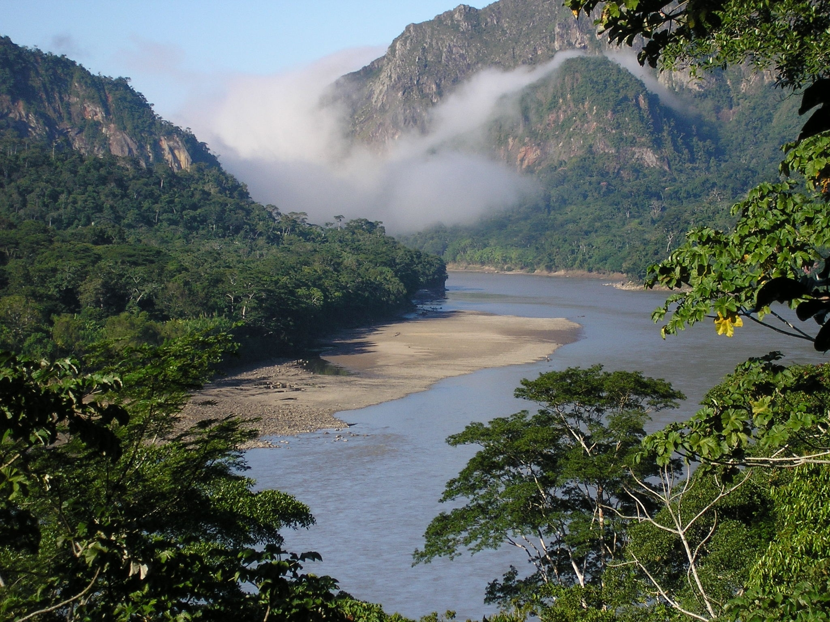
Thank you for your attention!

