Slide 1


Slide 2
2
Forum for Agricultural Research in Africa [FARA]
Notes:
2

Slide 3
Imperative for creation of
FARA
1997 FARA created during the 17th session of the Special Programme for African Agricultural Research (SPAAR) by SPAR and 3 SROs
1997-2000 SPAAR and FARA co-existed with a common Secretariat based at the World Bank in Washington DC
2000 SPAAR/FARA plenary resolved to transform SPAAR/FARA into a single apex organization—FARA

Slide 4





Rationale for Establishing FARA
  The fragmentation of the Continent 54 national research systems with limited capacities.
  Sub regional organisation collective actions support economies of scale
  Continental umbrella body to perform coordination, networking and advocacy functions at continental body
  Continental policy framework: A body to coordinate the translation of these into Ag. research programmes
  A representative of Africa in GFAiR

Slide 5



Functions and Structure of FARA
Vision: enhance and add value to achieve effectiveness and efficiency of agricultural research systems on the continent
(2002-2007)
Functions: Coordination, advocacy, information exchange, capacity strengthening, partnerships and networking
(2008-2013)
Mission: strengthen the capacity of Africa’s agricultural innovation system to contribute to improvement in productivity, competitiveness and markets.

Slide 6


Shaping FARA’s strategic agenda
Problem tree
Objective tree
No unified voice in regional and international forums to support AR
Strategic decision-making options for policy, institutions and markets
Inadequate transfer and use of technology-based innovations and information exchange
Appropriate institutional arrangements for AR established
Difficulties in forming partnerships across sub-regions
Broad- based stakeholders have access to knowledge and technology
Inadequate policy and market analysis
Human and institutional capacity for innovation developed
Weak institutional and human capacity
Platforms for agricultural innovation supported
Access to global and regional linkages for sustainable agricultural productivity, competitiveness and markets

Slide 7
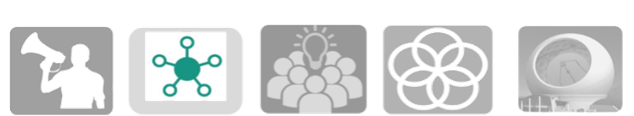
Core Function of FARA
Advocacy
R&D approaches.
Investment
Enabling
policy environment
Capacity Strengthening
Human.
Institutional
Systemic
Knowledge and Information Sharing
Consultations
Science week
ICT
Partnerships and Strategic Alliances
Inter continental
Regional
Operational
Coordination and
Futures
Intelligence gathering.
Situation analysis
Incubating initiatives

Slide 8
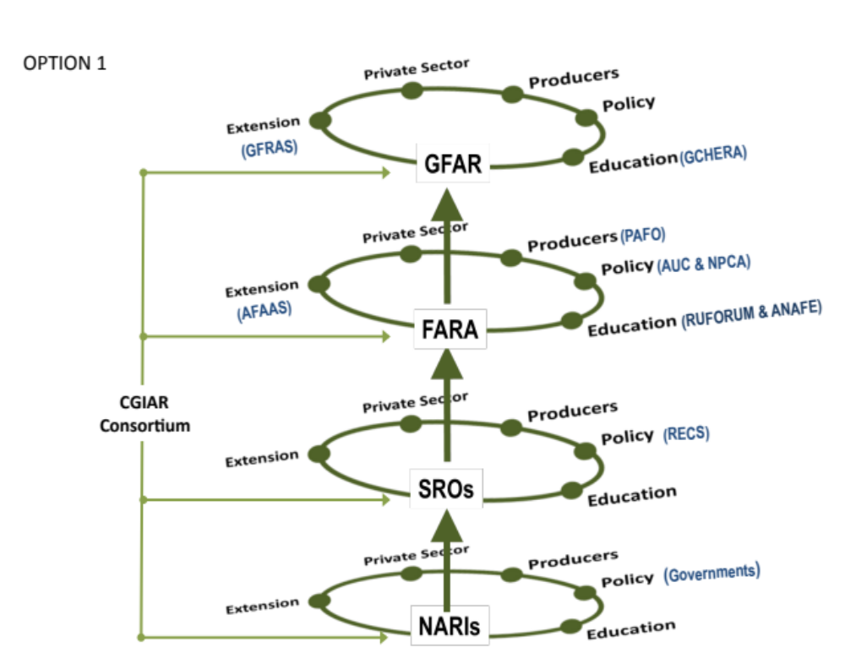
Ag R&I Institutional Architecture

Slide 9

Strategic Direction
Value Proposition
Africans’ unique Continental partnerships connecting science to agriculture for livelihood impact at scale
FARA is unique; it is a forum of all actors in agricultural research and innovation to drive collective actions to deploy the power of science to improve livelihoods on a large scale
The collective actions are around:
  Improving access to global and regional knowledge.
  Facilitating innovation-to-impact partnerships, advocating for policies and tested approaches.
  Enhancing capacities for innovation.

Slide 10
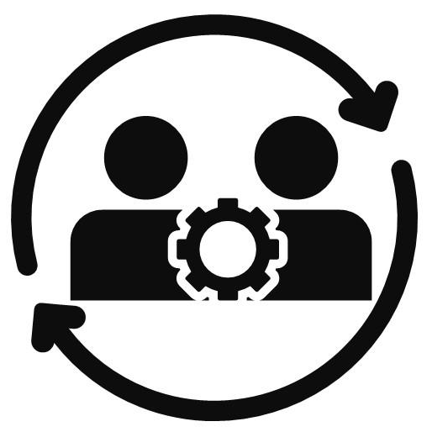
Emerging Issues Driving Change in Africa Agriculture
Increased use of ICT/ Digitalization.
Climate change.
Demand for farming system change / global pressure for Agroecology or regenerative agriculture
Increased awareness of gender and social exclusion issues.
Explosion in the youth population.
Awareness of the fragility in Africa’s agriculture/food system.
The push

Slide 11

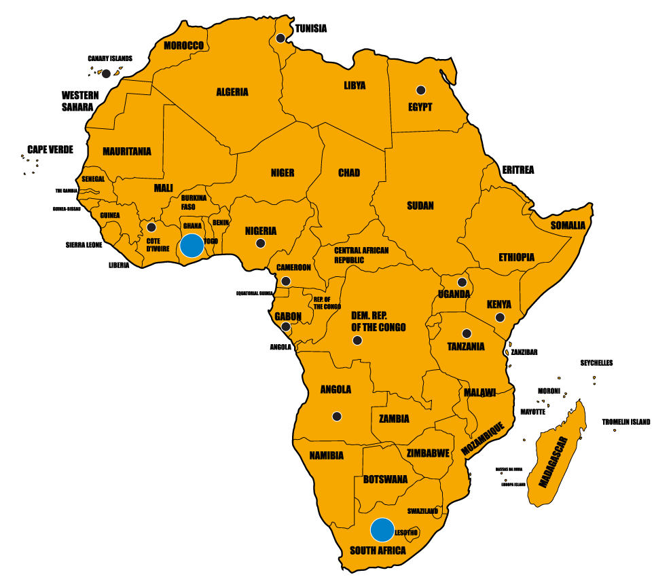
One Door to
Research Partnerships in
55 Africa Countries

Slide 12

FARA linkage with ……..
Collective Actions
Forgotten Foods
Inclusive digital transformation of Agriculture.
Collective action on Agroecology –pesticide
Transformation of higher education in Agriculture.
Land tenure and climate change
2IPS
KMDL
RPiN
ICF
2IPS

